Slide 1



Securing IR Communication from Replay Attacks
Aisha Kothare
Namruth Reddy

Slide 2
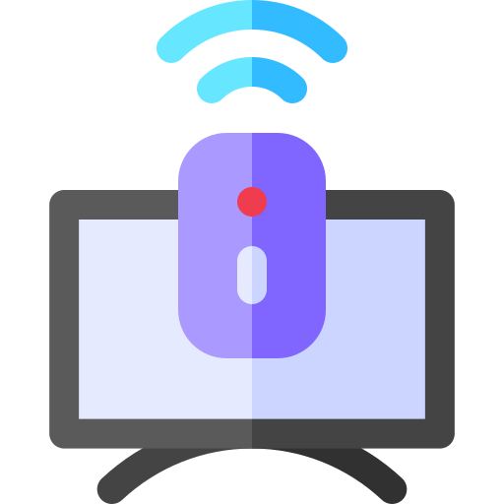
Introduction
Progression of IR to IoT - smart TVs, Hue lights
Low cost, low power.
Popular among battery-operated devices.
No interference with radio signals.
Greater flexibility and freedom of usage.
Replay attacks are very common.
no prior knowledge is needed.
Notes:
IR uses light waves.
IrDA- high-speed data transfer -mobile devices and computers.
-short-range wireless data transfer, typically up to 1 meter, and uses a low-power consumption mode to conserve battery life.
ZigBee- longer-range wireless -operates over distances of up to 100 meters.
-uses a mesh network topology -communicate without the need for a centralized control point. This makes it an ideal protocol for use in home automation systems, sensor networks, and industrial control systems.

Slide 3
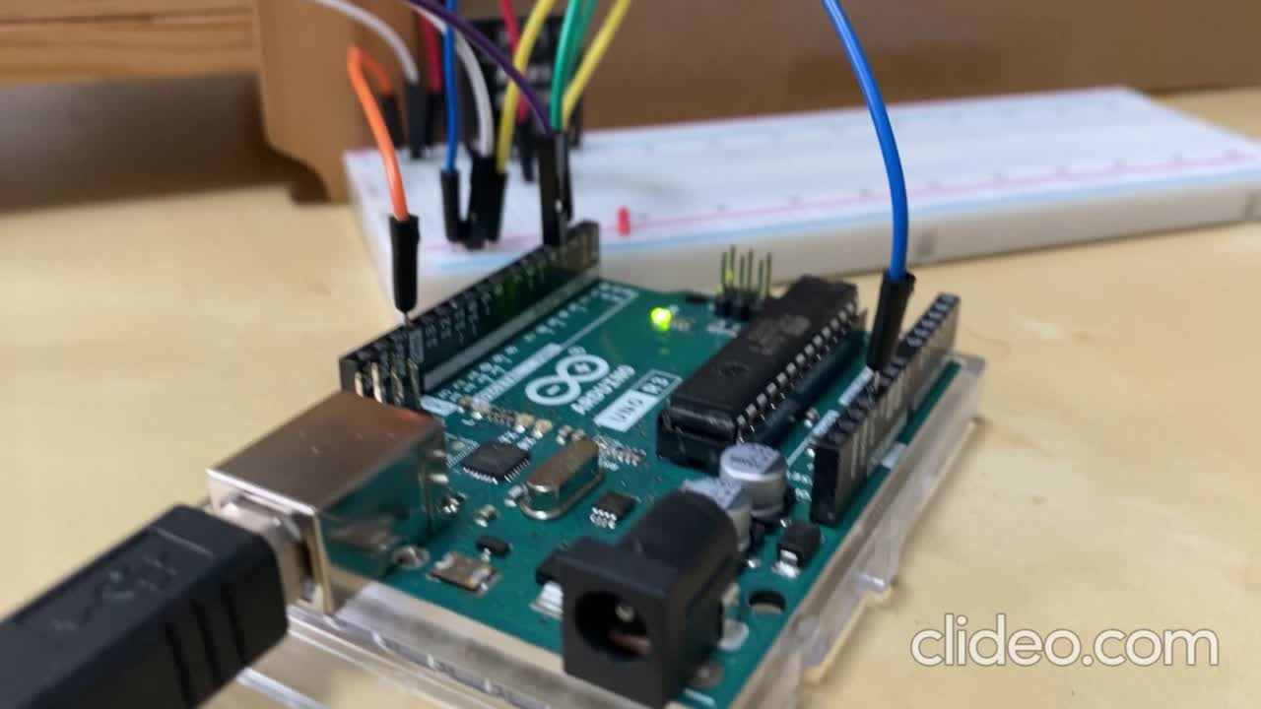
Some videos on replay attacks

Slide 4
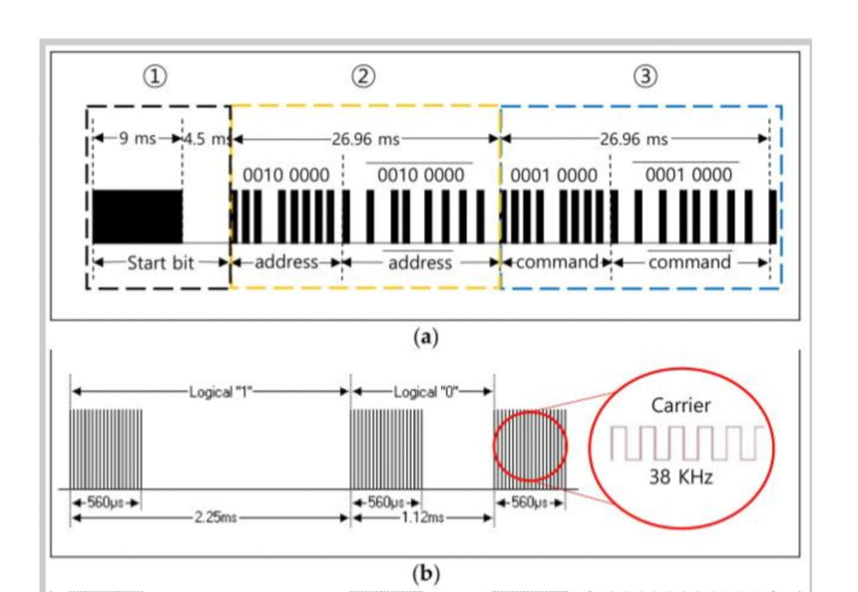
Background
Typically used in short-range communication.
Pulses are translated to binary codes to represent a function.
The choice depends on - device type, range, and data transfer speed.
NEC protocol - preferred in remotes.
Simple, low-power consumption.
NEC frame: 1-bit start + 8-bit address + 8-bit command.
Notes:
32 bits (16 bits for the device address and encryption key + 8 bits for the data + 8 bits for the repeat code) - second time all bits are inverted and can be used for verification of the received message.
Normal NEC - address, and command both transmitted as add+inv+comm+inv.
in extended - address low + add high + comm+inv
pulse distance modulation
logic 1: 560 micro high 1690 micro
logic 0: 560 micro high + 560 micro low

Slide 5
Secure IR communication
Session Keys
Time to Live
Using random session keys and counters for each session and packet respectively to distinguish real packets from replayed ones
Adding timestamps to packets to determine whether a packet is valid at a given time or not

Slide 6
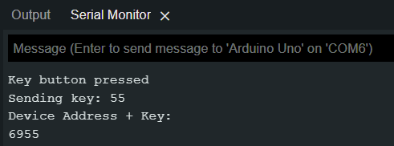
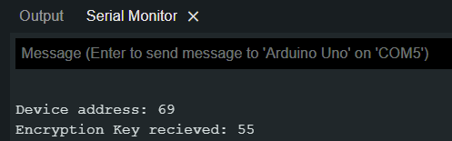
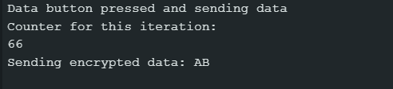
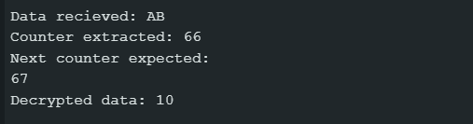
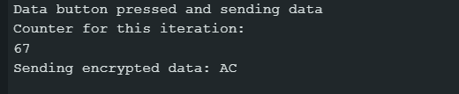
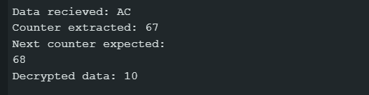
Session Keys

Slide 7
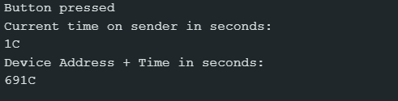
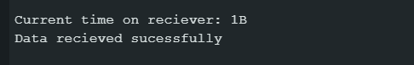
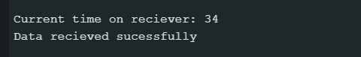
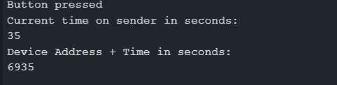
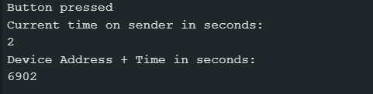
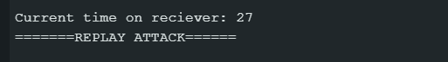
Time to Live

Slide 8
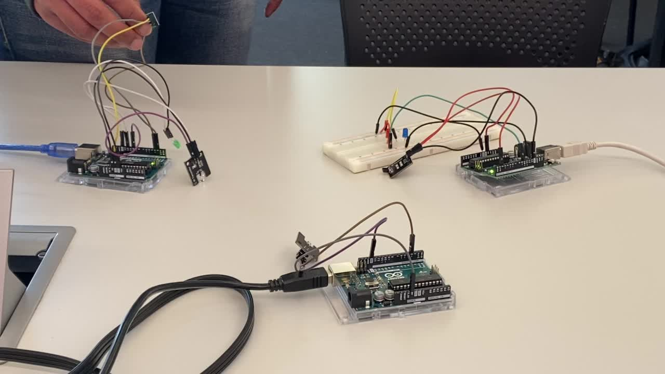

Demo
Session key

Slide 9
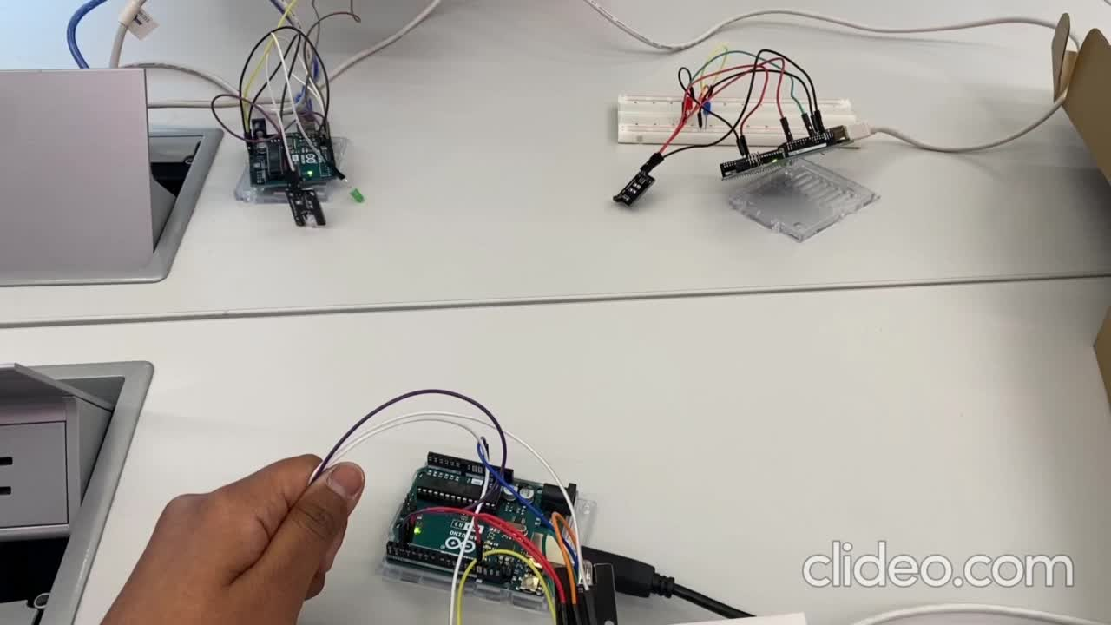
Demo
TTL

Slide 10
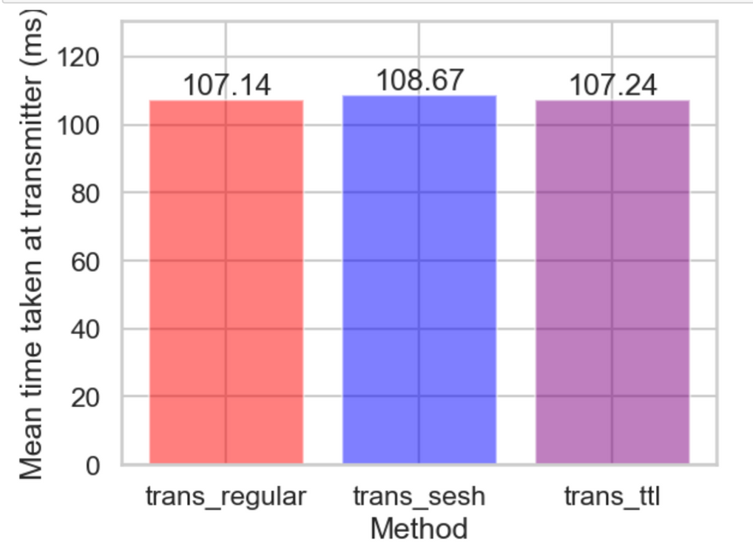
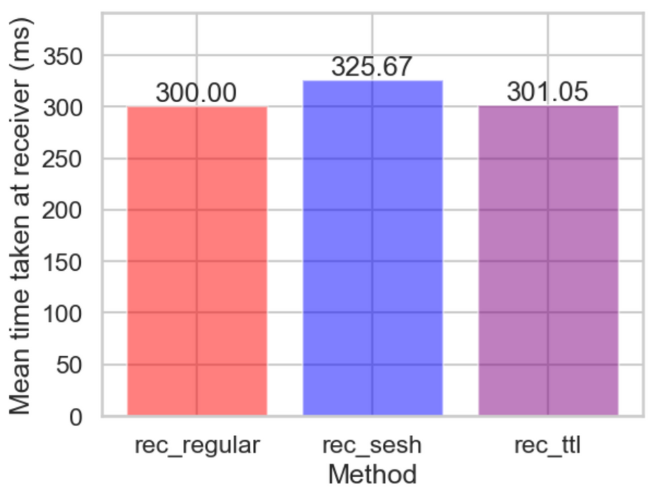
Evaluation

Slide 11
Challenges
Modifying NEC pakcet
Session key method
TTL method
synchronizing the transmitter and receiver was difficult.
Correct encoding and decoding at both transmitter and receiver.
Limit on data possible to share in one packet.
Implementing the logic to

Slide 12
Strengths and Limitations
Session Key
TTL
Strengths:
Doesn't require pre-existing synchronization.
Provides encryption, good for critical commands being transferred.
Weaknesses:
Can be vulnerable to brute force attacks in case of an advanced adversary.
Overhead in terms of creating and sharing the session key.
Strengths:
Not vulnerable to brute force attacks.
Displayed similar performance to regular NEC protocol.
Weaknesses:
Doesnt prevents eavesdropping attacks.
Can be broken if the threshold is figured and the packet is successfully replayed in that frame.

Slide 13
Conclusion
Understanding IR communication, protocols, and applications.
Conducting replay attacks on real-world devices such as lights, TV, bell, and more.
Proposing two solutions to prevent replay attacks.
Evaluation of both the solutions for performance, strengths, and limitations.
Demo of replay attacks and solutions

Slide 14
Thank you!
Questions?

